Slide 1
14 Feb 2022
Cloud Data Integration Training – Day 1
.
Notes:
Insert your picture

Slide 2
Agenda

Slide 3
Agenda
Why CDI
PODs and Orgs
IICS Architecture
IPU’s

Slide 4

























DATA CONSUMERS
ETL Developer
Data Engineer
Citizen Integrator
Data Scientist
Data Analyst
Business Users
Intelligent Data Management Cloud
DISCOVER & UNDERSTAND
ACCCESS & INTEGRATE
CONNECT & AUTOMATE
CLEANSE & TRUST
MASTER & RELATE
GOVERN & PROTECT
SHARE & DEMOCRATIZE
DATA
CATALOG
DATA INTEGRATION
API & APP INTEGRATION
DATA
QUALITY
MDM & 360 APPLICATIONS
GOVERNANCE & PRIVACY
DATA
MARKETPLACE
10K+ Metadata-Aware Connectors
AI-Powered Metadata Intelligence & Automation
Connectivity Metadata System of Record
DATA SOURCES
SaaS Apps Sources
+
On-premises Sources
+
Real-time / Streaming Sources
Mainframe
Applications
Databases
IoT
Machine Data
Logs
Notes:
Welcome to Informatica cloud platform; every cloud-native service you will ever need for data management. One cloud platform... INFA Cloud is industry's first and most comprehensive AI-powered data management platform.
Our customer can perform from discovery to democratization of data using our cloud services. Our home-grown CLAIRE helps in AI Powered metadata intelligence and automation services. We have the wide range of connectivity with our cloud and it’s the best in class.. Our connetcors can connect to the breadth and depth of all data sources available in the market. And if there is a niche source, customers can always build it with out kit or use existing common connectivity services like webservices, ODBC, JDBC, REST and the list goes on…

Slide 5
Why CDI
Notes:
We did see there are numerous offerings available in our cloud but today we are going to deep-dive on the integration part. Why Integration or CDI in technical terms?
INFA has 2 major cloud journeys, the DW/DL journey and modernization journey. Have you every wondered what would be a common service used in ALL of our cloud journeys? Let’s figure out

Slide 6
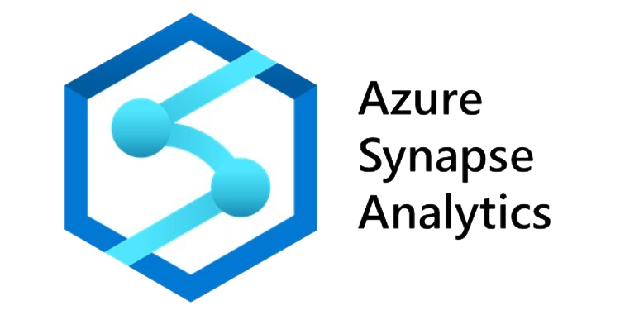

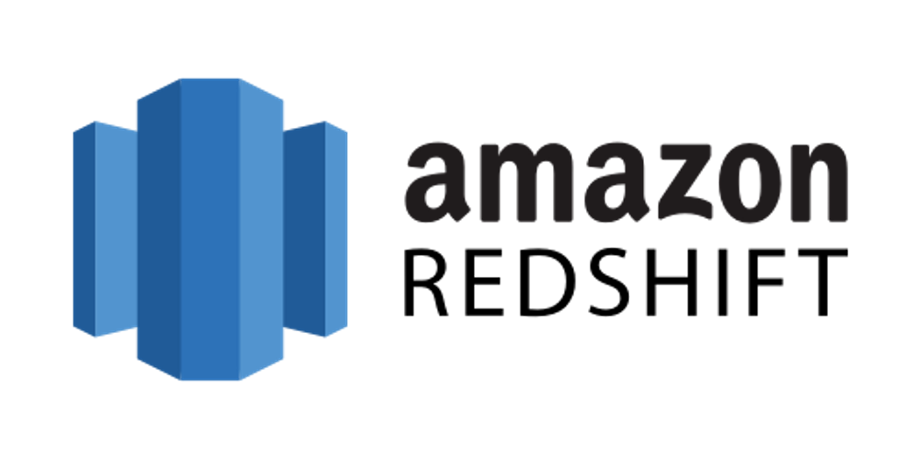


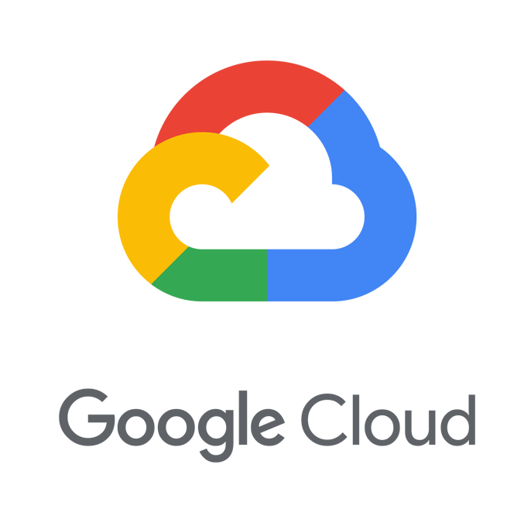




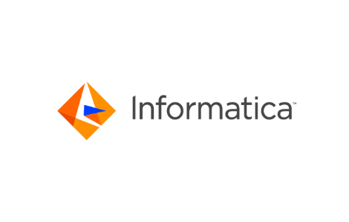
CDW/DL
Cost Overruns: Optimization Engine
Pushdown
=
Informatica sends the work to a Cloud Ecosystem or Data Warehouse
Cloud Data Warehouse
=
Cloud Ecosystem
Spark
Informatica sends the work to a large number of Spark servers
Traditional ETL
Do the work on an Informatica server
Notes:
In CDW/ DL journey customers can these expectation
I want to perform the tradition ETL
I want to do heavy data processing in an elastic server, can you do it?
I have a super powerful ecosystem already in place, can you make max use of it.
Now, from INFA Cloud who can perform all these operations?
It’s simple our humble CDI.

Slide 7
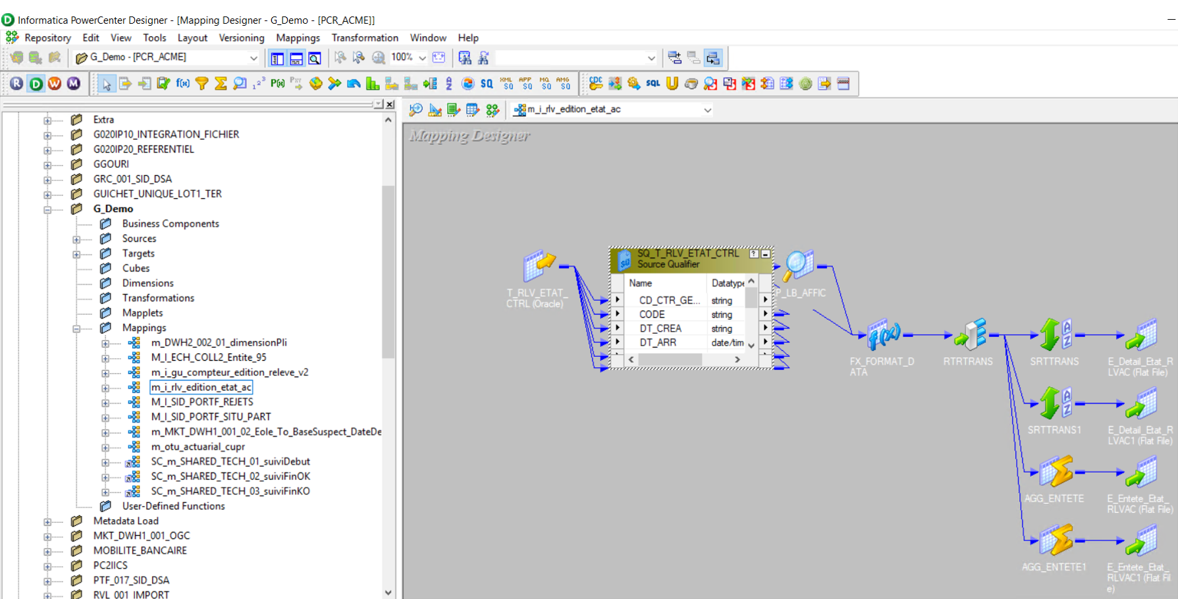
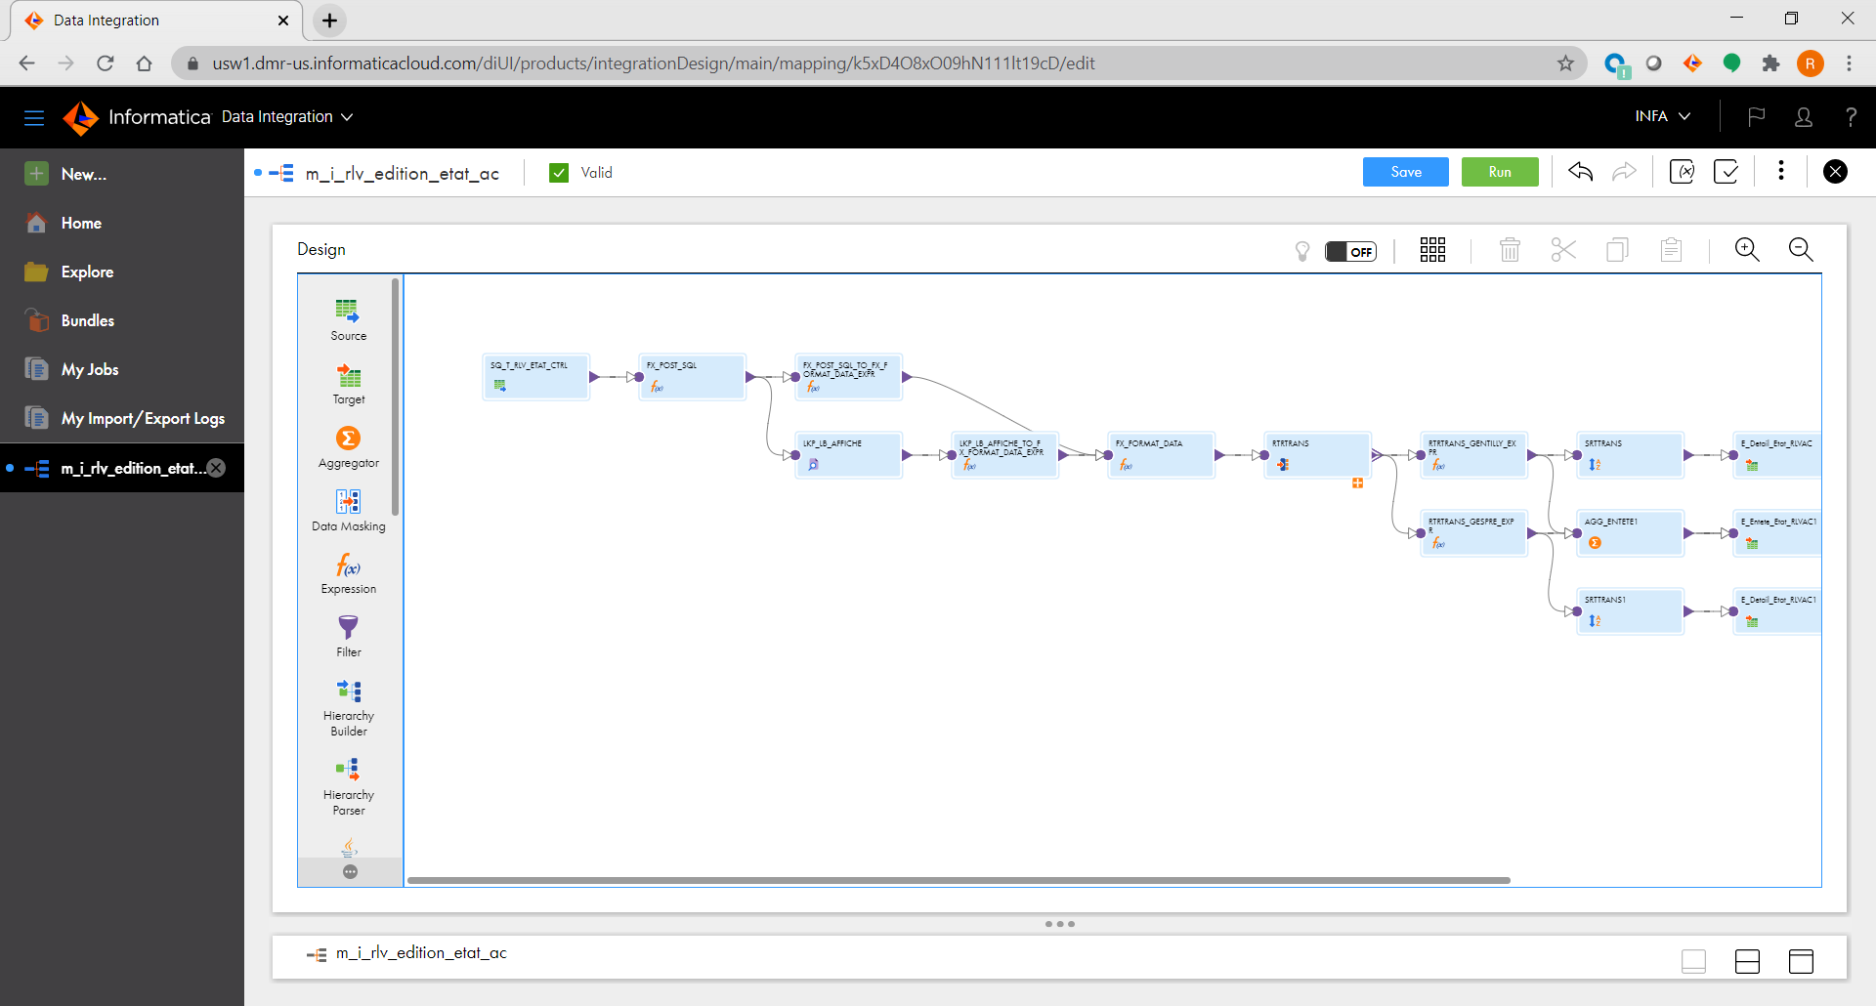
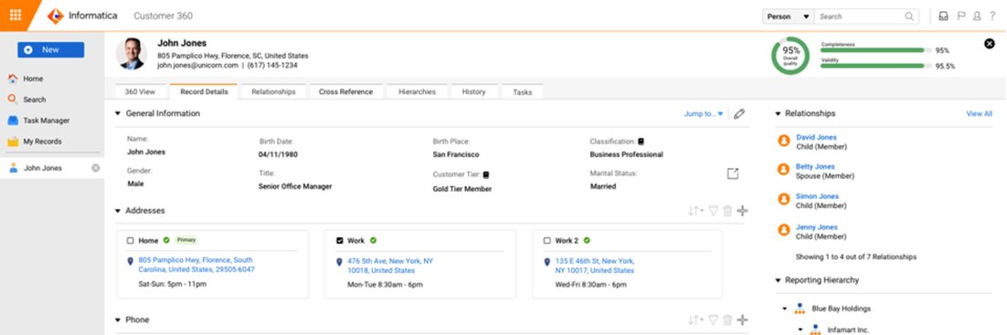
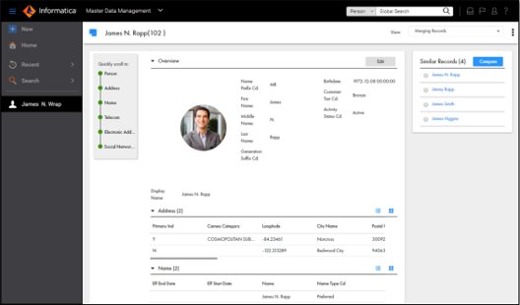
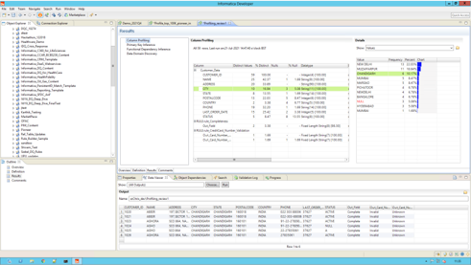
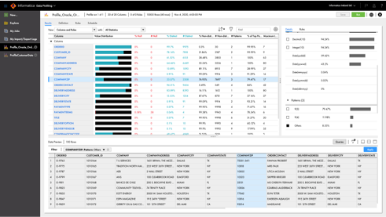
Informatica Modernization program
PowerCenter
Cloud Data Integration
Start Small and Scale
Begin with your most critical use-case
Hybrid is O.k
Side by Side support while you Modernize
Customer 360
C360 SaaS
Informatica Data Quality
Cloud Data Quality
Notes:
Let’s take the most popular journey among our long-time INFA customers – Modernization.
When customer’s think of modernization, they want to move their traditional ETL, Complete customer insight and their data quality solutions. Customers also prefer to start small in an area they are quite comfortable with or the area where the already have expertise or experts available.
DQ solution will move into our cloud DQ, Customer insight will move into our SaaS platform and finally the traditional integrations will move into our CDI. Now if you look closely, the ONLY common solution in all our journeys in CDI and that’s why we are deep diving on CDI today.

Slide 8
Refresher
IICS basics
Notes:
Lets refresh some of our basic terminologies / concepts before we do further

Slide 9
IICS Basics refresher
POD (US-West 1)
Walmart PROD
Walmart Sandbox
Sodexo
Ford
Customer XYZ
Single or Multi- Tenant
16 pods WW
AWS , Azure, GCP
Notes:
POD – Point of Deployment which hosts the repository and all services of our cloud platform.
Org is a secured area specific to 1 customer. Org holds all of their licenses, assets created in IICS.
We support single tenant and multi-tenant. As the name suggests single tenant hosts only 1 customer. The Pod and org are specific to that customer. In multi- tenant architecture many customers of ours share the same POD. The org they hold is secured and accessible only by that customer, customers in that POD are neither aware nor access others org. Single tenant is like your villa, multi-tenant is your apartment.
WW we have 16 POD’s, 10 in NA, 3 in EMEA and 3 in APAC.
We offer PODs on all cloud ecosystem like Azure, AWS and GCP

Slide 10
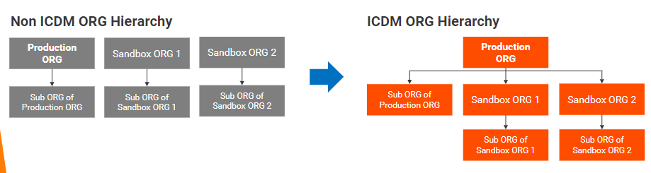
Informatica Cloud Orgs
Secure Area in IICS to store User Accounts, Licenses, Data Integration Assets like mappings, tasks, schedules, security etc.
Notes:
Lets see how the Orgs were mapped in IICS licensing vs our new ICDM/IPU licensing
In IICS licensing the Orgs were in silos and in ICDM we have a clear hierarchy model for our customer orgs, this is required for metering

Slide 11
Informatica Cloud Orgs - FAQ
CSM contacts Customer to gather additional information
All information will be collected from the system as part of mandated fields
CSM links Orgs and Contracts manually
Linkage of Orgs to Contracts will happen automatically through the system
CSMs request for detailed usage reports for Adoption indicators
This will be made available in Cassini in the future
Customers with Orgs in Multiple regions - CSMs need to send usage report to Customer periodically
Usage reports are automated and sent to CSMs by email as part of an email schedule.
The same can be downloaded OnDemand as well from the following link
SOC-2 compliance - CSM follow up to restore deleted expired Orgs
Notification will be sent to AM and CSM 30 days before expiry
For any issues with Org Provisioning, please escalate with Informatica Support

Slide 12
Cloud Architecture

Slide 13
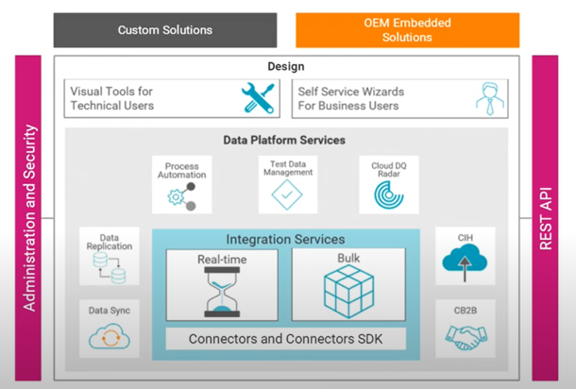
IICS Platform Architecture

Slide 14
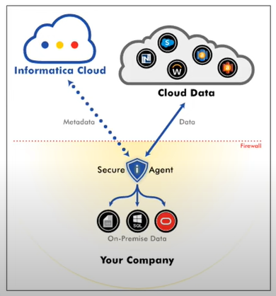
IICS Agent

Slide 15
ICDM / IPU

Slide 16




Flexible License Aligned to Your Journey
Consumption model based on the Informatica Processing Unit
Cloud Friendly
Usage Based
Comprehensive
Flexible
Elastic
Cloud native services aligned to customer journey and preferences
Informatica Processing Unit (IPU) is a unit of software licensing capacity measured by service usage
Interchangeably use units across integration and quality services, with included connectivity
Monthly measurements allow different architecture and deployment options as business needs change
Scale up and down to meet demand as data volumes and performance requirements evolve
Informatica Intelligent Cloud Services
CDI Elastic
API & App
Mass
Ingest
Mass Ingest DB
Mass Ingest Stream
CDI
CDI Serverless
CDQ
B2B
Data Masking
APDO
CDC
Integration Hub
Compute Hours
Data Volume
Rows Processed
Events
IPUs

Slide 17
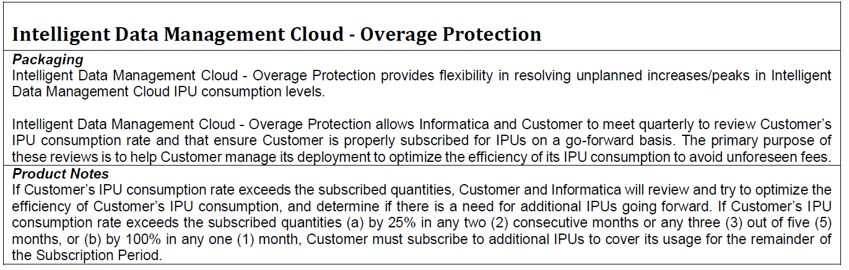
Overage Protection

Slide 18


Cassini for ICDM
Consumption
Entitlements
Ask Cassini

Slide 19


Consumption – in detail
Current Billing Period to Date
Entitlement Vs Consumption
Cumulative and Detailed Org Level Summary
History
Usage by Service
Trending
Cassini - ICDM

Slide 20
Appendix
.
Notes:
Insert your picture

Slide 21
Jargons
Data Integration Glossary1
Data Integration Glossary2
Amazon
Amazon Services
Top Amazon Products & Services
A Guide to AWS Products
Overview of Amazon Services
Microsoft Azure
Azure Products Chart
Google Cloud Platform (GCP)
SAP
Databricks
Snowflakes
Salesforce

Slide 22
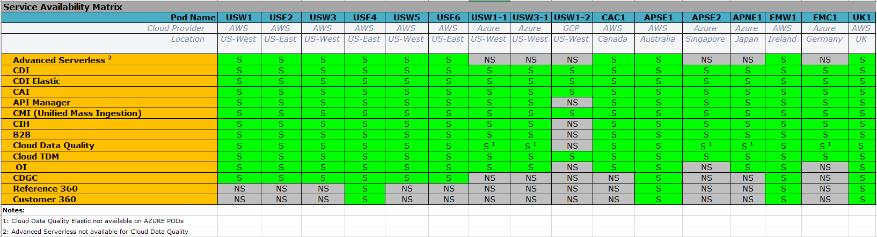
PODs
North America
APJ
EMEA
IPU Metering - Advisable for the Parent/Child or Sandbox/Prod Org to be in the same POD
Note: If customer is using Azure Ecosystem, they don’t have to necessarily use the Azure POD.
** Subject to change. Refer PAM
Notes:
Move adv serverless to the top
Move Ref 360, Customer360 last

Slide 23
IICS Security Architecture
More on IICS Architecture

Slide 24
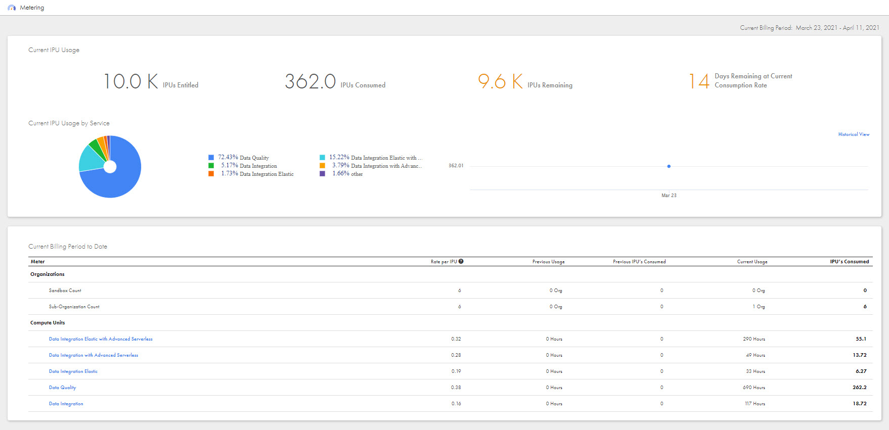
IPU
In 2021 Informatica introduced usage-based pricing model.
An Informatica processing unit (IPU) is a unit of credit used to pre-pay for using Informatica Intelligent Cloud Services scalars such as compute units and events processed.
IPU metering page in IICS Administrator is used for
viewing IPU metrics and is displayed in dashboard view.
More details can be found here.
Documentation
Metering Measurement
Notes:
1. Demo IPU using Cassini
2. Legal rules around IPU (??)
We don’t do compliance stuff on IPU Overusage

